Slide 1
Change log
July 29th 2021
Added ECS Anywhere introduction slides (game changer, how it works, benefits, pricing)
Updates ECS Networking slides to include ECS Anywhere and none option for ECS Anywhere
Updated Storage slide to reflect changes to free ephemeral storage and the ability to adjust the ephemeral storage
https://aws.amazon.com/about-aws/whats-new/2021/04/amazon-ecs-aws-fargate-configure-size-ephemeral-storage-tasks/
Added ECS Anywhere to the Hosting options on “AWS Container Services Landscape” slide.

Slide 2
Introduction to Amazon ECS and AWS Fargate
Containers Immersion Day: Module 3

Slide 3

AWS container services landscape
Management
Deployment, Scheduling, Scaling & Management of containerized applications
Amazon Elastic
Container Service
Amazon Elastic
Kubernetes Service
Hosting
Where the containers run
ECS Anywhere
Amazon EC2
AWS Fargate
EKS Anywhere
Image Registry
Container Image Repository
Amazon Elastic
Container Registry
Notes:
SAY: We’ve already spent some time talking about the current AWS container services landscape.
SAY: For this session, we’re going to focus on at the orchestration or management layer and explore Amazon ECS.
SAY: We will also look at how you can currently run your containers on ECS using on of two Launch Types: either the EC2 launch type – where get to manage the the underlying instances on which your containers are running - or you can choose to run your containers in a serverless manner with the AWS Fargate launch type.

Slide 4
Amazon Elastic
Container Service
Notes:
SAY: Amazon ECS is a fully managed container orchestration platform. It operationalizes your container workload at very high scale without having you to install any software. It’s a multi-tenant service and can spin up large number of cluster, services, and tasks underneath.

Slide 5


Scheduling and Orchestration
ECS
Cluster Manager
Placement Engine
Notes:
SAY: Scheduling and orchestration are key components of ECS and the cluster manager and the placement engine play specific roles to help accomplish these.
SAY: Cluster manager manages health of the instances within your cluster. You set up an auto scaling group and register your instances with your cluster. ECS is then aware of the capacity you desire for your containers.
SAY: Placement engines on the other hand enables much advanced techniques for how you want to place your tasks onto the EC2 instance. For e.g. if you have certain tasks that you want to land on certain instance types or if you desire super-efficient bin-packing for better economics, the placement engine enables you to do that.

Slide 6
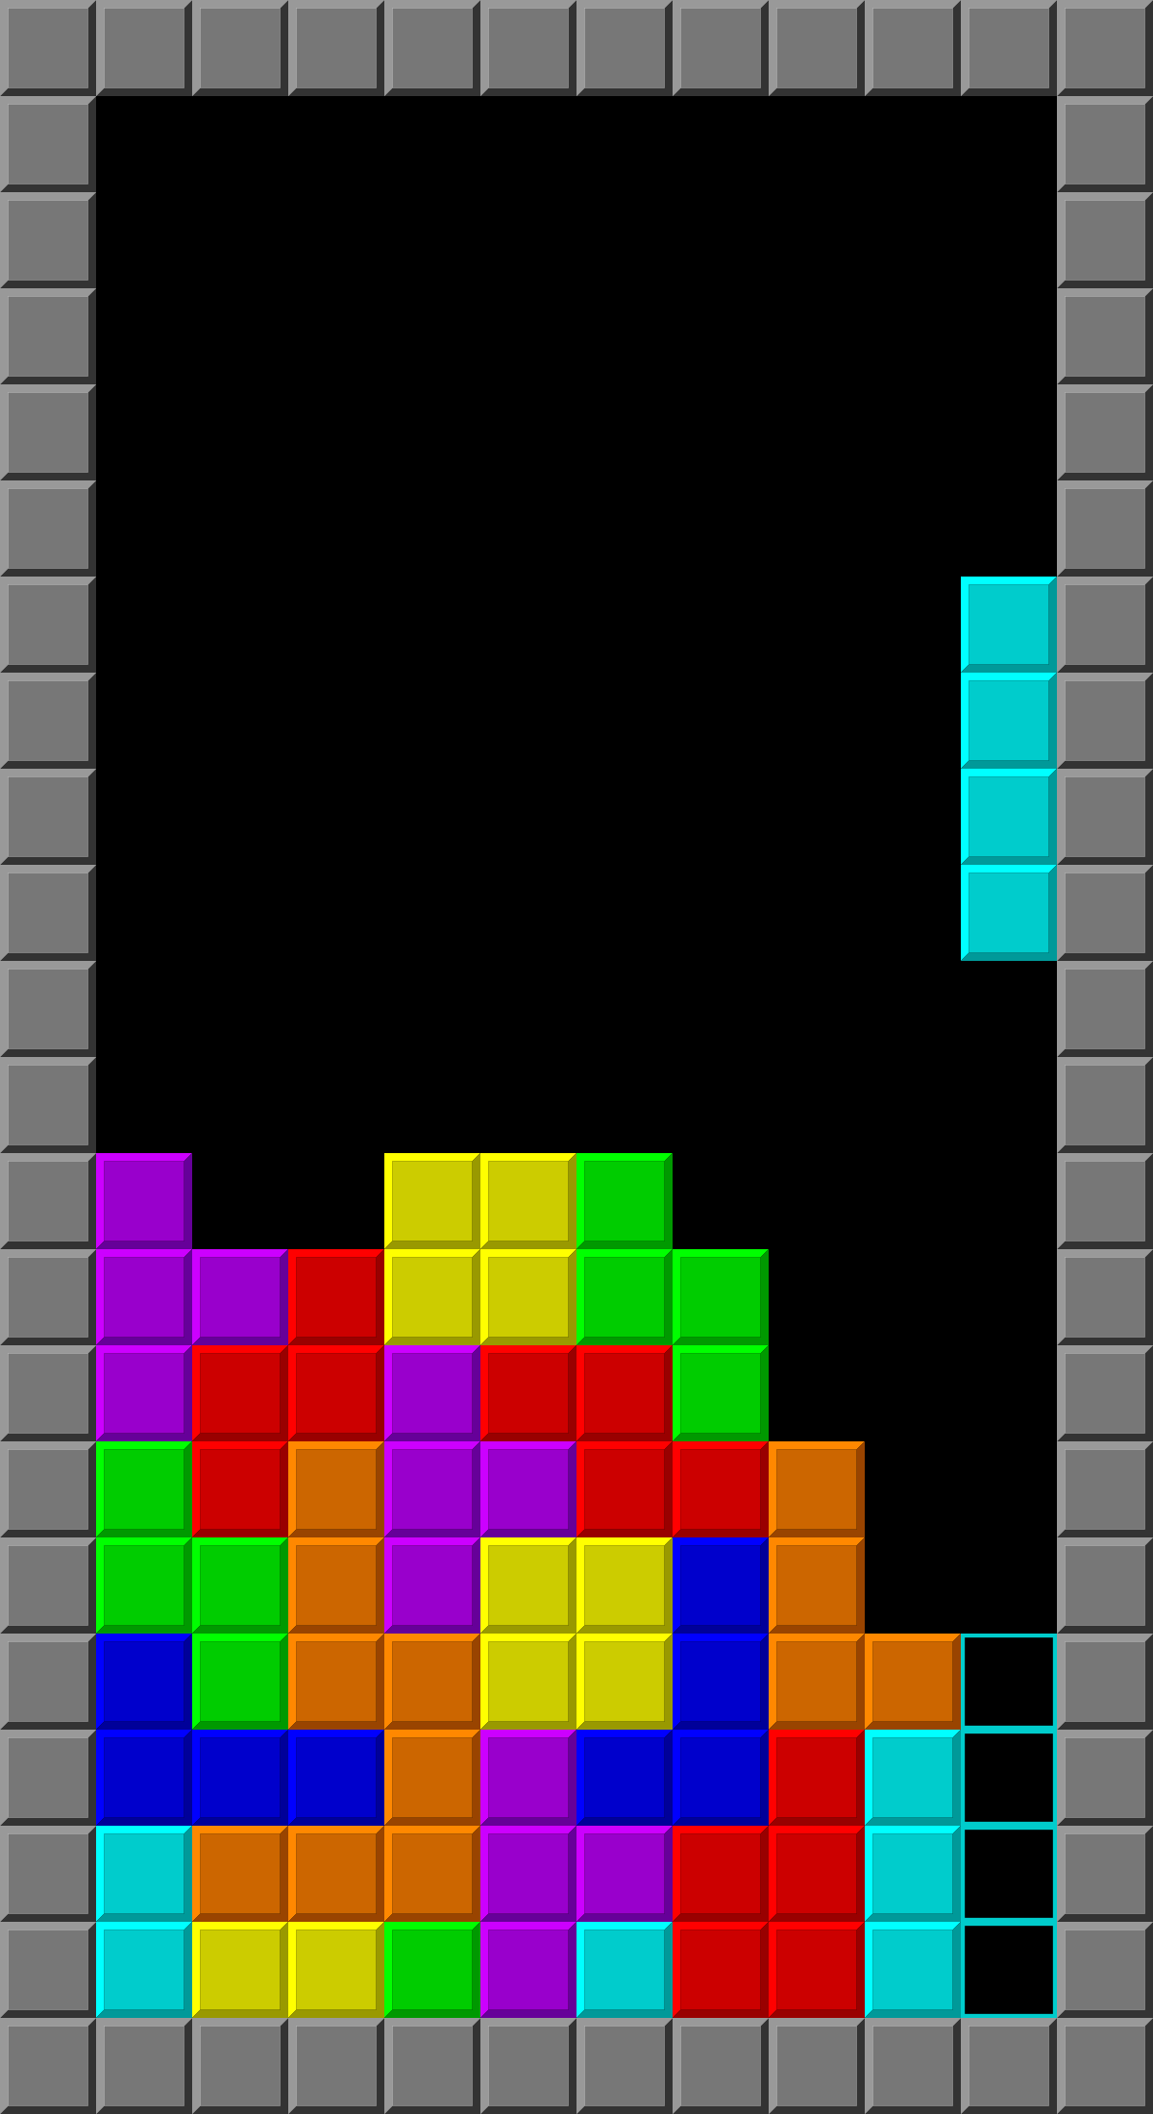
Notes:
SAY: This is how I like to think about scheduling … The objective of the game of Tetris is to use the pieces – which are tiles that come in a number of geometric forms - to create as many horizontal lines of blocks as possible. Or, in other words, make them fit in the most efficient way possible. Sound familiar?

Slide 7
Notes:
SAY: Lets explore the components of ECS in a bit more detail … <CLICK>

Slide 8
Amazon ECS constructs
Cluster
Resource grouping and isolation
IAM permissions boundary
Notes:
SAY: Let’s start with the CLUSTER: An Amazon ECS cluster is a logical grouping of tasks or services. If you are running tasks or services that use the EC2 launch type, a cluster is also a grouping of container instances. If you are using capacity providers, a cluster is also a logical grouping of capacity providers. When you first use Amazon ECS, a default cluster is created for you, but you can create multiple clusters in an account to keep your resources separate.

Slide 9

Amazon ECS constructs
Cluster
Resource grouping and isolation
IAM permissions boundary
Container Instance
Notes:
SAY: Next we have CONTAINER INSTANCES: An Amazon ECS container instance is an Amazon EC2 instance that is running the Amazon ECS container agent and has been registered into an Amazon ECS cluster. When you run tasks with Amazon ECS using the EC2 launch type or an Auto Scaling group capacity provider, your tasks are placed on your active container instances.

Slide 10

Amazon ECS constructs
Cluster
Resource grouping and isolation
IAM permissions boundary
{ ; }
JSON
Container Instance
Task definition
Template used by Amazon ECS to launch tasks
Parallels to docker run parameters
Defines requirements:
CPU/Memory
Container image(s)
Logging
IAM role
Etc.
Container 1
Container 1
Task
Running instance of a task definition
One or more containers
Notes:
SAY: Then there are TASKS AND TASK DEFINITIONS: A task is an instantiation of a task definition that is running on a container instance or in AWS Fargate. A Task Definition is the the blueprint for your task. Specifies the name of the task, revisions, container definitions, and volume information.

Slide 11

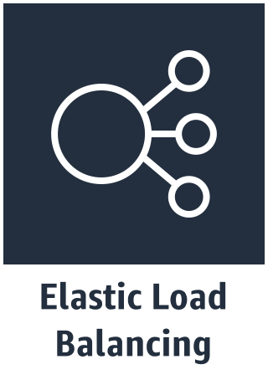
Amazon ECS constructs
Cluster
Resource grouping and isolation
IAM permissions boundary
{ ; }
JSON
Container Instance
Task definition
Template used by Amazon ECS to launch tasks
Parallels to docker run parameters
Defines requirements:
CPU/Memory
Container image(s)
Logging
IAM role
Etc.
Container 1
Container 1
Container 1
Container 1
Task
Running instance of a task definition
One or more containers
Service
Maintains desired # of running tasks
Replaces unhealthy tasks
ELB integration
Container 1
Notes:
SAY: Let’s start with the CLUSTER: An Amazon ECS cluster is a logical grouping of tasks or services. If you are running tasks or services that use the EC2 launch type, a cluster is also a grouping of container instances. If you are using capacity providers, a cluster is also a logical grouping of capacity providers. When you first use Amazon ECS, a default cluster is created for you, but you can create multiple clusters in an account to keep your resources separate.
SAY: Next we have CONTAINER INSTANCES: An Amazon ECS container instance is an Amazon EC2 instance that is running the Amazon ECS container agent and has been registered into an Amazon ECS cluster. When you run tasks with Amazon ECS using the EC2 launch type or an Auto Scaling group capacity provider, your tasks are placed on your active container instances.
SAY: Then there are TASKS AND TASK DEFINITIONS: A task is an instantiation of a task definition that is running on a container instance or in AWS Fargate. A Task Definition is the the blueprint for your task. Specifies the name of the task, revisions, container definitions, and volume information.
SAY: Finally, we have SERVICES: An Amazon ECS service enables you to run and maintain a specified number of instances of a task definition simultaneously in an Amazon ECS cluster. If any of your tasks should fail or stop for any reason, the Amazon ECS service scheduler launches another instance of your task definition to replace it in order to maintain the desired number of tasks in the service.

Slide 12
Task definition
{
"containerDefinitions": [
{
"memory": 128,
"portMappings": [
{
"hostPort": 80,
"containerPort": 80,
"protocol": "tcp"
}
],
"essential": true,
"name": "nginx-container",
"image": "nginx",
"logConfiguration": {
"logDriver": "awslogs",
"options": {
"awslogs-group": "ecs-log-streaming",
"awslogs-region": "us-west-2",
"awslogs-stream-prefix": "fargate-task-1"
}
},
continued…
"cpu": 0
}
],
"networkMode": "awsvpc",
"executionRoleArn": "arn:aws:iam::123456789012:role/ecsTaskExecutionRole",
"memory": "2048",
"cpu": "1024",
"requiresCompatibilities": [
"FARGATE"
],
"family": "example_task_1"
}
Notes:
SAY: A task definition is and immutable, versioned document, Identified by family:version. Task definitions can contain a list of up to 10 container definitions.
SAY: All containers defined with a task definition are co-located (co-scheduled) on the same host.
SAY: Each container definition has A name, Image URL (ECR or Public Images) and more…stay tuned

Slide 13
Deploying on ECS: Tasks vs Services
On-Demand Workloads
ECS task scheduler
Run once or at intervals
Batch jobs
RunTask API
StartTask (custom)
Long-Running Apps
ECS service scheduler
Health management
Scale-up and scale-down
AZ aware
Grouped containers
Notes:
SAY: We’ve talked about Tasks and Services and we’ve explained some of the differences between them, but which one do you use for your particular workload?
SAY: For on-demand workloads, the ECS task scheduler is the best option. It is ideal for workloads that need to run once, or at recurring intervals. Things like batch or short-lived operations. This task scheduler kicks in when the RunTask API is invoked.
SAY: For long running workloads, the ECS service scheduler is used. It provides health management features, to ensure workloads are up and responding correctly. The ECS service scheduler also supports the scaling up and down of workloads and has an awareness of availability zones. These features make it ideal of workloads that need to be highly available and scale to meet changes in demand.

Slide 14
Task placement
Cluster Constraints
Satisfy CPU, memory, and networking requirements
Custom Constraints
Filter for location, instance-type, AMI, or other custom attribute constraints
Placement Strategies
Identify instances that meet spread or binpack placement strategy
Apply Filter
Select final container instances for placement
Notes:
SAY: Let’s look at a scenario where you had 10 container instances. To start you’ll make a request to run some tasks or create a service. As part of that request you’ll specify CPU, memory, or port requirements.
SAY: In addition now, you’ll also provide other constraints, such as specific Availability Zone, AMI or instance-type.
SAY: And then last you’ll tell us the strategy you prefer for us to use when starting the tasks, which could range from spread for availability, binpack to optimize for utilization, place together (affinity) or place apart (anti-affinity), etc.
SAY: At the end of that process we have identified a set of instances that satisfies the requirements for the task you want to run and we place (or run) those tasks across your cluster based on the requirements specified.

Slide 15




Amazon ECS powers Amazon
Amazon SageMaker
Amazon Lex
Amazon Polly
AWS Batch
Amazon ECS forms the building blocks for various services at Amazon
Built for security, reliability, availability, and scale
Notes:
SAY: Amazon ECS also runs Amazon. Many AWS services teams choose to build on ECS for the same reasons our external customers do.

Slide 16
AWS Fargate
Notes:
SAY: As customers were adopting ECS to manage complex containerized application, we realized that they still ended up managing more than just containers. There are these additional layers of management they need to manage when all they wanted to do was run containers!
SAY: To overcome this challenge, we launched AWS Fargate which is a serverless way to run containers.
SAY: Both ECS and EKS (Elastic Kubernetes Service) support running containerised workloads using AWS Fargate. We will explore Fargate for EKS in a later module, for the moment, we will be looking at it from a ECS perspective.

Slide 17


Without Fargate, you end up managing more than just containers
EC2 Instance
OS
Container Rungime
ECS Agent
Notes:
SAY: Let’s look at an example to better understand how Fargate helps you run serverless containers. Without Fargate, you’ve an EC2 instance with 2 tasks running on it .
SAY: A task is a collection of containers that run together as a unit of your application. So here to support the 2 tasks you have to manage the underlying instance such the instance OS, the container runtime, as well as, in the case of Amazon ECS, the ECS Agent. This is still quite a bit of operational overhead.

Slide 18
- Patching and Upgrading OS, agents, etc.
- Scaling the instance fleet for optimal utilization
Notes:
SAY: So you end up having to to patch and update the OS, ECS agent etc while also scaling the instance fleet for optimal utilization.
SAY: All of these tasks are still required which add layers of management to your application.

Slide 19
Amazon Elastic Container Service
Notes:
SAY: And this is what your layers of management end up looking like. You’ve this completely managed orchestration or container management layer but you also have these software management layers just to run your application.

Slide 20
Amazon Elastic Container Service
AWS Fargate
run serverless containers
Notes:
SAY: And all you really want here is to run your containers. And Fargate enables you to do just that in a serverless manner. So if you notice here, there are no 2 levels of management of scale anymore. You only define the requirement of your application in terms of a task – how should the service scale, what metrics do you care about and how many more such container or task you want Fargate to launch.
SAY: At this point, you might be asking yourself how do I ensure that my tasks are running on the latest and greatest managed components? What if, for example, I want to use a feature that is only supported in newer versions of the Amazon ECS container agent?
SAY: Great question … <CLICK>

Slide 21
AWS Fargate platform versions
Amazon Elastic Container Service
AWS Fargate
Platform version 1.4.0
Notes:
SAY: Which brings us to AWS Fargate Platform Versions.
SAY: AWS Fargate platform versions are used to refer to a specific runtime environment for Fargate task infrastructure. It is a combination of the kernel and container runtime versions.
SAY: New platform versions are released as the runtime environment evolves, for example, if there are kernel or operating system updates, new features, bug fixes, or security updates
SAY: Security updates and patches are deployed automatically for your Fargate tasks
SAY: If a security issue is found that affects a platform version, AWS patches the platform version

Slide 22
AWS Fargate
Managed by AWS
No EC2 Instances to provision, scale or manage
Elastic
Scale up & down seamlessly. Pay only for what you use
Your containerized applications
Integrated
With the AWS ecosystem: VPC Networking, Elastic Load Balancing, IAM Permissions, CloudWatch and more
Notes:
SAY: Let’s quickly re-cap on Fargate ….
We launched Fargate in November 2017
With the primary goal of completely managed infrastructure.
You don’t have to worry about patching or upgrading or how do I pick the right instance type or instance size
and its fully integrated with the AWS ecosystem.
SAY: We have over the years invested in making the container the first level primitive of the AWS platform which means when it comes to IAM resources or networking or load balancers or integration with VPC, it is all built into ECS and Fargate takes advantage of that.

Slide 23
Fully managed container environment with AWS ECS + Fargate
Bring existing code
Production ready
Powerful integrations
No changes required of existing code, works with existing workflows and microservices built on Amazon ECS
ISO, PCI, HIPAA, SOC compliant. Launch ten or tens of thousands of containers in seconds in 9 global regions (+7 in 2018)
Native AWS integrations for networking, security, CICD, monitoring, and tracing
Fargate runs tens of millions of containers for AWS customers every week
Notes:
Customers that want fully managed services that abstract the underlying infrastructure include teams at the largest enterprises and smaller companies that are born in the cloud.They see their ability to develop and deliver new technology products as a critical differentiator and want fully managed services that enable them to build without requiring them to build things themselves and investing in hiring or training staff that have infrastructure management skills.
Fargate works with Amazon ECS so you can bring your existing code and applications and run them.
Fargate is HIPAA eligible and ISO, PCI, and SOC compliant so you can run critical production applications.

Slide 24
Amazon ECS Anywhere
Notes:
SAY: AWS customers have continuously sought more flexibility in where they could deploy containers using Amazon ECS. They had an increasing number of use cases that required applications to run outside AWS Regions and closer to their other services, wherever they may be located.
SAY: Customers love the simplicity of Amazon ECS and the fact that “it just works.” However, their deployment requirements may go beyond AWS owned infrastructure and they can’t afford to use different container management technologies for different deployment targets. To make their investments sound, they need to focus on a single experience that allows them to achieve the flexibility that they need.
SAY: To address this requirement, we launched ECS Anywhere, and extension of ECS. ECS Anywhere will allow customers to deploy native Amazon ECS tasks in any environment. This will include the traditional AWS managed infrastructure, as well as customer-managed infrastructure. All this without compromising on the value of leveraging a fully AWS managed, easy to use, control plane that’s running in the cloud, and always up to date.

Slide 25

ECS Anywhere: Game-changer
Fully managed cloud control plane
No need to run, update, or maintain container orchestrators on-premises
Consistent tooling and governance
Use the same tools and APIs
for all container-based applications regardless of operating environment
Manage your hybrid footprint
Run applications in on-premises environments and easily expand to cloud when you're ready
Amazon Elastic
Container Service
On-premises
customer-owned Virtual Machines, bare metal servers
Amazon EC2
in
AWS Outposts
VMware Cloud
on AWS
Amazon EC2:
AWS regions
AWS Local Zones
AWS Wavelength
AWS Fargate
on-premises
Managed in the cloud
Notes:
SAY: Customers running containers on-premises find the tools complex and requiring a lot of management and operational overhead. Platform teams at these companies want to to unblock their developer teams to deploy containers but today they have to choose between expensive support models or managing on their own.
SAY: With ECS Anywhere we want to maintain the same fully managed control plane but let you bring in your compute and let you launch the containers on those compute such as AWS local zones, AWS Wavelength and AWS Outposts and Customer infrastructure.
SAY: Now, customers no longer need to operate a separate local container management software such as Mesos or Kubernetes, ECS now helps customers standardize container management across all of their environments, and enables ability to add on-premises environment to ECS, ECS Anywhere simplifies and reduces the complexity for customers migrating container workloads to the cloud.

Slide 26




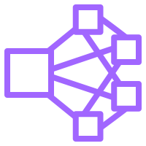




Amazon ECS Anywhere—how it works
AWS Cloud
Customer data center
Amazon CloudWatch
Amazon ECS
ECS cluster
ECS Agent
ECS Agent
ECS task
SSM Agent
SSM Agent
OS
OS
AWS Systems Manager
AWS IAM
Notes:
SAY: The way ECS Anywhere works at a very high level, is that customers will install the AWS Systems Manager (SSM) agent on a supported operating system (such as amazon linux) and securely connect that new customer-managed infrastructure to the AWS cloud.
SAY: Once the SSM agent has made a connection, you’ll deploy the open source ECS agent to connect this new customer managed infrastructure as “capacity” in the ECS console.
SAY: Finally, this new customer-managed infrastructure that has been securely connected to the ECS control plane running at AWS can be used to schedule ECS tasks and run your containers just like any other capacity (such as Fargate or EC2) .... and ECS Anywhere is designed to deliver the same powerful simplicity you get at AWS, which means you’re able to easily connect to other AWS services and use consistent IAM roles and tooling

Slide 27
Key benefits of ECS Anywhere
Fully managed cloud control plane
Consistent tooling and governance
Manage your hybrid footprint
No need to run, update, or maintain container orchestrators on-premises
Use the same tools and APIs for all container-based applications regardless of operating environment
Run applications in on-premises environments and easily expand to cloud when you're ready
Notes:
SAY: As a reminder, here are some of the key benefits of ECS Anywhere:
Customers no longer need to operate a separate local container management software such as Mesos or Kubernetes
ECS now helps customers standardize container management across all of their environments, and enables ability to add on-premises environment to ECS
Simplifies and reduces the complexity for customers migrating container workloads to the cloud
ASK: Can you think of any use cases you have where ECS Anywhere might be suitable?

Slide 28




ECS Anywhere pricing
You only pay for running instances managed by ECS Anywhere.
Each managed ECS Anywhere on-premises instance is charged $0.01025 per hour, starting from when you register the instance with ECS Anywhere to when the instance is deregistered
The free tier includes 2200 instance hours for each month for six months per account for all regions
Notes:
You only pay for running instances managed by ECS Anywhere
Each managed ECS Anywhere on-premises instance is charged $0.01025 per hour, starting from when you register the instance with ECS Anywhere to when the instance is deregistered
The free tier includes 2200 instance hours for each month for six months per account for all regions

Slide 29
Networking
Notes:
SAY: Before going any further, we need to address a bit of networking. I know this is not everyone's cup of tea but let’s try to keep is as brief as possible.

Slide 30
ECS and Fargate networking modes
Mode
Bridge | YES | NO | YES
Host | YES | NO | YES
awsvpc | YES | YES | NO
None | YES | NO | YES
Notes:
SAY: There are four primary modes of networking available in for containers running on ECS (on EC2, AWS Fargate and ECS Anywhere) SAY: If the network mode is bridge, the task utilizes Docker's built-in virtual network which runs inside each container instance (EC2 and ECS Anywhere)
SAY: If the network mode is host, the task bypasses Docker's built-in virtual network and maps container ports directly to the EC2 instance's network interface directly. In this mode, you can't run multiple instantiations of the same task on a single container instance when port mappings are used (EC2 and ECS Anywhere)
SAY: If the network mode is awsvpc, the task is allocated an elastic network interface, and you must specify a NetworkConfigurationwhen you create a service or run a task with the task definition. For more information, see Task Networking with the awsvpc (EC2 and AWS Fargate)
SAY: If the network mode is none, the task has no external network connectivity (EC2 and ECS Anywhere)

Slide 31

Networking modes: Bridge
Security
group
EC2 Instance / Container Instance
Container 1
Container 2
Host process (SSH)
172.16.32.2:80
172.16.32.3:80
192.168.1.11:22
Docker bridge
172.16.32.0/24
Host eth0
192.168.1.11:22
VPC
Notes:
SAY: In Bridge mode, containers connect to the Docker virtual bridge. This allows multiple containers on the same host to use the same ports without running in to conflicts. This is because a range of dynamic ports is used to map to the container ports to the host ports. This most does not offer the best performance

Slide 32
Networking modes: Host
Security
group
EC2 Instance / Container Instance
Container 1
Host process (SSH)
192.168.1.11:22
192.168.1.11:80
Host eth0
192.168.1.11:22
VPC
Notes:
SAY: In Host networking mode uses containers use the EC2 networking stacking. Containers configured to run in host mode share the EC2 instances network name space Containers can share the same IP as your host, this also means that you cannot have multiple containers on the same host, using the same port.
SAY: In other words, a port used by one container cannot be used by another container on the same host, if host networking mode is configured.

Slide 33






Networking modes: awsvpc
Client
Internet
Internet
VPC
VPC
Public subnet
Public subnet
Security
group
NAT gateway
ENI
Private subnet
Security
group
Task
ENI
Task
Notes:
SAY: In awsvpc networking mode (or task networking) Amazon ECS tasks (running on EC2 or AWS Fargate) get many of the same networking properties as Amazon EC2 instances.
SAY: When you use the awsvpc network mode in your task definitions, every task that is launched from that task definition gets its own elastic network interface (ENI) and a primary private IP address
SAY: The task networking feature simplifies container networking and gives you more control over how containerized applications communicate with each other and other services within your VPCs.
SAY: Task networking also provides greater security for your containers by allowing you to use security groups and network monitoring tools at a more granular level within your tasks.

Slide 34
Storage
Notes:
SAY: Most applications need storage and so let us take a few minutes to look at the intersection between storage and containers when used ECS and Fargate.

Slide 35
Layer storage - ephemeral
Container images are composed of layers - topmost layer is the writable layer to capture file changes made by the running container
20 GB layer storage available per task across all containers, including image layers
Writes are not visible across containers
Ephemeral storage is not available after the task stops
10 GB per task
Writable layer
Writable layer
Image layers
Image layers
Container 1
Container 2
Notes:
SAY: There are several use cases for using data volumes in Amazon ECS task definitions. We give the following guidance, broken down by launch type.
SAY: For Amazon ECS on Fargate, tasks using platform version 1.4.0 or later, each task receives 20 GB of ephemeral storage. The amount of storage is configurable. You will get 20GiB of free ephemeral storage by default and will only be charged for any additional storage that you request. The ability to increase the ephemeral storage for your Tasks running on AWS Fargate allows you to run a wide range of workloads such as machine learning inference, extract-transform-load (ETL), and other data processing. This feature also enables you to run Tasks on AWS Fargate where container images larger than 20 GiB need to be downloaded locally to start the task.
SAY: For tasks using platform version 1.4.0 or later that are launched on May 28, 2020 or later, the ephemeral storage is encrypted with an AES-256 encryption algorithm using an AWS Fargate-managed encryption key.

Slide 36

EFS storage
Need persistence beyond the task lifecycle?
Fargate platform version 1.4 supports mounting EFS file systems to containers in your task.
Configure via NFS mounts in task definition
Can mount at different container paths
Container 1
Container 2
/usr/share/nginx/html
/usr/share/nginx/html
NFS
Mount
fs-1324abcd
Notes:
SAY: Amazon Elastic File System, or EFS, provides a simple, scalable, elastic, fully managed shared file system; it means that you can store your data separately from your compute. It is also a regional service, meaning that the service is storing data within and across 3 Availability Zones for high availability and durability.
SAY: Both containers running on ECS and AWS Fargate will be able to use EFS.
SAY: This capability will help customers containerize applications that require shared storage such as content management systems, internal DevOps tools, and machine learning frameworks.
SAY: There are a range of workloads that can now enjoy the benefits containers bring, enabling customers to speed up their deployment process, optimize their infrastructure utilization, and build more resilient systems.
Ref: https://aws.amazon.com/blogs/aws/amazon-ecs-supports-efs/

Slide 37
Security

Slide 38
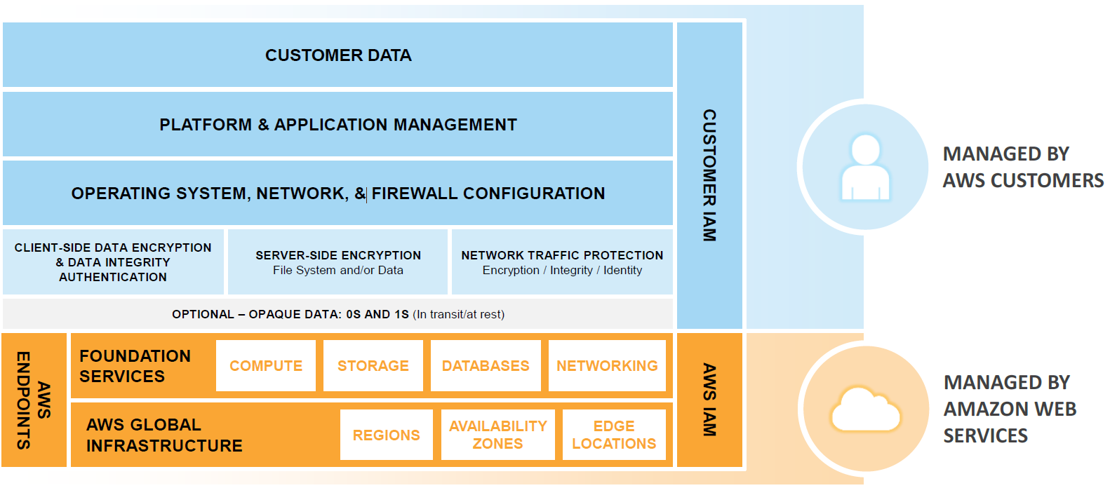
Working together
Security in the Cloud is a Shared Responsibility
Customer Data
Platform & Application Management
Security IN the Cloud
Managed by customers
Customer IAM
Operating System, Network & Firewall Configuration
Client Side Data Encryption & Data Integrity Authentication
Server Side Encryption
File System and / or Data
Network Traffic Protection
Encryption / Integrity / Identity
Optional – Opaque Data: 0s and 1s (In Transit and At Rest)
Foundation
Services
Security OF the Cloud
Managed by AWS
Compute
Storage
Databases
Networking
AWS Endpoints
AWS IAM
AWS Global
Infrastructure
Regions
Availability Zones
Edge Locations
https://aws.amazon.com/compliance/shared-responsibility-model/
Notes:
Notes:
Security of the cloud, includes the security measures that AWS implements and operates – such as:
Protecting the global infrastructure that runs all of the services offered in the AWS cloud
Protection of large-scale AWS service endpoints
Ongoing audit and assurance programs
Culture of security and improvement
Security in the cloud – these are the measures that you as the customer implement and operate in order to secure the data, content and applications that make use of AWS services:
Customers configure AWS security features
Can implement and manage their own controls
Choose additional assurance above AWS controls
Gain access to a mature vendor marketplace
Professional services engagements:
Cloud adoption framework
Privacy by Design

Slide 39
Shared responsibility model: Amazon ECS for EC2
APPLICATION
HARDENING
MONITORING
PATCHING
ECS AGENT
CONTAINER
TASK
CUSTOMER IAM
MANAGED BY
CUSTOMER
CONTAINER INSTANCE CONFIG.
HARDENING
MONITORING
PATCHING
NETWORK CONFIGURATION
NACLs
SECURITY GROUPS
ROUTE TABLES
VPC
APP
CLIENT-SIDE ENCRYPTION
SERVER-SIDE ENCRYPTION
NETWORK TRAFFIC PROTECTION
HOST
DATA
AWS IAM
ECS CONTROL PLANE
COMPUTE
STORAGE
DATABASES
NETWORKING
FOUNDATION
SERVICES
MANAGED BY
AWS
AWS IAM
AWS
ENDPOINTS
AWS GLOBAL
INFRASTRUCTURE
REGIONS
AVAILABILITY ZONES
EDGE LOCATIONS
Notes:
SAY: Looking at how the shared responsibility model looks in the context of Amazon ECS with EC2 instances

Slide 40


Security: IAM Roles for Tasks
EC2 Instance / Container Instance
IAM Role
Cats container
Dogs container
Cats Bucket
Dogs Bucket
Undesired permission
Notes:
SAY: One example of a responsibility that sits “above the line” is the management of AWS IAM. One feature that we built to help our customers manage IAM with ECS is IAM roles for Amazon ECS Tasks.
SAY: With IAM roles for Amazon ECS tasks, you can specify an IAM role that can be used by the containers in a task. Applications must sign their AWS API requests with AWS credentials, and this feature provides a strategy for managing credentials for your applications to use, similar to the way that Amazon EC2 instance profiles provide credentials to EC2 instances. Instead of creating and distributing your AWS credentials to the containers or using the EC2 instance’s role, you can associate an IAM role with an ECS task definition or RunTask API operation.
SAY: In this example, if we used the IAM role associated with the EC2 instance, all containers on the host would inherit permissions from the instance role. This might allow, for example, the cats container to access the dogs bucket – this isn’t desireable.

Slide 41

Security: IAM Roles for Tasks
EC2 Instance / Container Instance
Cats container
Dogs container
IAM Role
IAM Role
Cats Bucket
Dogs Bucket
Notes:
SAY: With IAM Roles for tasks, permissions can be applied at the task level, ensuring containers only have privileges to do the things they need to do. Taking our cats and dogs example, now, because we have unique roles for each container, the cats container no longer has access to the dogs bucket.

Slide 42
Shared responsibility model: Amazon ECS for AWS Fargate
APPLICATION
HARDENING
MONITORING
PATCHING
ECS AGENT
CONTAINER
TASK
CUSTOMER IAM
MANAGED BY
CUSTOMER
CONTAINER INSTANCE CONFIG.
HARDENING
MONITORING
PATCHING
NETWORK CONFIGURATION
NACLs
SECURITY GROUPS
ROUTE TABLES
VPC
APP
CLIENT-SIDE ENCRYPTION
SERVER-SIDE ENCRYPTION
NETWORK TRAFFIC PROTECTION
HOST
DATA
AWS IAM
ECS CONTROL PLANE
COMPUTE
STORAGE
DATABASES
NETWORKING
FOUNDATION
SERVICES
MANAGED BY
AWS
AWS IAM
AWS
ENDPOINTS
AWS GLOBAL
INFRASTRUCTURE
REGIONS
AVAILABILITY ZONES
EDGE LOCATIONS
Notes:
SAY: Things change a bit with regards to the shared responsibility model when we run workloads on AWS Fargate.
SAY: With Fargate, we take care of that Instance and OS-level work for you and let you focus on your containers and telling ECS how to run them.

Slide 43
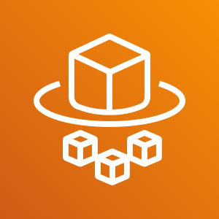
Security: Benefits of Fargate
We do more, you do less.
Patching (OS, Docker, ECS Agent, etc.)
Task isolation (via Clusters)
No --privileged mode for containers
Requires awsvpc network mode so there is an ENI and SG per Task
No runtime access for users (ssh or interactive container shell)
Notes:
SAY: There are some additional security benefits beyond patching as well - including that we isolate each Task within its own Cluster. So, if you don’t want to Tasks to share a kernel, run them on different clusters. There is no additional cost – and because clusters don’t cross accounts, and therefore customers, you’re Tasks will never share an instance/kernel with another you don’t intend or that is outside of your control.
SAY: We also do not allow --privileged mode for the container which gives them more access to the Docker daemon and host than we’d like for a secure managed service.
SAY: We require the awsvpc network mode which gives you an isolated network interface, where you can leverage security group ingress and egress rules, for each Task.
SAY: And, finally, we don’t allow runtime (i.e. ssh or docker exec) access to the container or host.

Slide 44
Questions?
Introduction to Amazon ECS and AWS Fargate
Notes:
SAY: Any questions on what we just covered?

Slide 45

Containers Immersion Day: Hands-on labs
Notes:
SAY: Time to get back to our hands-on labs …

Slide 46
Welcome to Mythical Mysfits
Our mission: Ethical, mythical creature care.
Our priority: Find homes for the abandoned, and often misunderstood, mythical creatures in our community.
Help us find their forever homes!
Your mission: Modernize and innovate on the Mythical stack.
Lab 1: Containerize the monolithic application.
Lab 2: Deploy containers using AWS Fargate.
Lab 3: Scale and lay the foundation for microservices with an AWS Application Load Balancer.
Lab 4: Our developers completed Project Cuddle which adds a “like” feature to the application. Since we want to move to a microservices design, help us break this functionality from the monolith and deploy it with AWS Fargate as its own containerized microservice.
Notes:
SAY: If you cast your mind back to our earlier labs, we containerised the monolith and pushed it to an ECR repository. The next set of labs are going to build on the work we’ve already done …

Slide 47




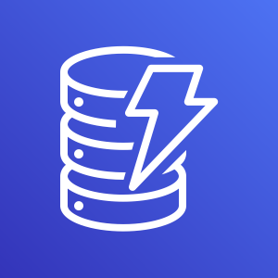
Lab 2: Deploy monolith with Fargate
AWS Cloud
VPC
Amazon S3
Users
Public subnet
Private subnet
Monolith
Amazon CloudWatch
Logs
Fargate
Amazon ECR
Amazon DynamoDB
Notes:
SAY: You’re going to be using the container that we created previously and deploying it using Amazon ECS and AWS Fargate.

Slide 48

Lab 3: Scale with an Application Load Balancer
AWS Cloud
VPC
Application Load Balancer
Amazon S3
/
Users
Private subnet
Private subnet
Monolith
Amazon CloudWatch
Logs
Fargate
Amazon ECR
Amazon DynamoDB
Notes:
SAY: You will then look at moving the services behind a load balancer to show you how load balancers can be easily integrated to help scale your service.

Slide 49
Lab 4: Deploy ”like” microservice
AWS Cloud
VPC
/fulfill-like
Amazon S3
/like
/
Users
Private subnet
Private subnet
Monolith
Like microservice
Amazon CloudWatch
Logs
Fargate
Fargate
Amazon ECR
Amazon DynamoDB
Notes:
SAY: Finally, we will break out some functionality from our monolith application to support independent management and scaling of the like service.
Let’s get going!

Slide 50

Auto Scaling
WIP
Notes:
SAY: Auto scaling or Automatic scaling is the feature that increases or decreases the desired count of EC2 instance and or tasks in your Amazon ECS services automatically.
SAY: There are two type of scaling we need to consider when we think about scaling applications with Amazon ECS.
<CLICK>
…

Slide 51



Amazon ECS cluster autoscaling
WIP
Capacity provider
Used to determine infrastructure needed to run tasks.
Capacity provider strategy
Gives you control over how your tasks use one or more capacity providers
Default capacity provider strategy
Determines capacity provider strategy used if not other capacity provider or launch type is specified.
ECS Cluster
ECS Cluster
ECS Tasks
EC2 Auto Scaling Group
EC2 Instances
Notes:
SAY: The first type is auto scaling of EC2 instances
SAY: Auto scaling groups can increase or decrease the number of instances based on alrms triggered by threshold
ECS uses a feature called ECS cluster auto scaling to provide more controls over the instances in your cluster.
SAY: ECS cluster auto scaling is enabled by another feature called capacity providers.
<CLICK>

Slide 52
Amazon ECS capacity providers
WIP
Capacity provider
Used to determine infrastructure needed to run tasks.
Capacity provider strategy
Gives you control over how your tasks use one or more capacity providers
Default capacity provider strategy
Determines capacity provider strategy used if not other capacity provider or launch type is specified.
ECS Cluster
ECS Cluster
ECS Capacity Provider
ECS Tasks
EC2 Auto Scaling Group
EC2 Instances
Notes:
SAY: The second type is auto scaling of services. ECS leverages the Amazon Application Auto Scaling service to provide this functionality.
SAY: Let’s start with capacity providers and the role they play in enabling you to manage the infrastructure that the tasks in your clusters use (and by extension, the ECS cluster auto scaling feature).
SAY: There are three core concepts you need to understand with for capacity providers.
SAY: A capacity provider: is used in association with a cluster to determine the infrastructure that a task runs on.
SAY: Capacity provider strategy: A capacity provider strategy gives you control over how your tasks use one or more capacity providers.
SAY: Default capacity provider strategy: A default capacity provider strategy is associated with each Amazon ECS cluster. This determines the capacity provider strategy the cluster will use if no other capacity provider strategy or launch type is specified when running a task or creating a service.
ref: https://aws.amazon.com/blogs/containers/deep-dive-on-amazon-ecs-cluster-auto-scaling/

Slide 53




Three type of scaling policies
WIP
AWS Cloud
Target Tracking
Scale based on a target value for a specific metric
ECS Cluster
ECS Service
Step Scaling
Scale based on a set of scaling adjustments, or steps, that vary based on the size of the alarm breach
Scheduled Scaling
Scale based on the date and time
Alarm
Amazon CloudWatch
Amazon Application
Auto Scaling
Notes:
SAY: There are three types of scaling policies available for ECS services.
SAY: Target tracking increases or decrease the number of tasks that your service runs based on a target value for a specific metric. This is similar to the way that your thermostat maintains the temperature of your home. You select temperature and the thermostat does the rest.
SAY: Step scaling policies Increase or decrease the number of tasks that your service runs based on a set of scaling adjustments, known as step adjustments, that vary based on the size of the alarm breach.
SAY: Scheduled scaling policies Increase or decrease the number of tasks that your service runs based on the date and time.
SAY: ECS publishes metrics about your services average CPU and memory usage to Amazon CloudWatch. You can use these, or other CloudWatch metrics to scale out your service. Amazon Application Auto Scaling monitors the alarms associated with the your service and changes the desired count based on your requirements.
SAY: Let’s try and scale something ….
Ref: https://docs.aws.amazon.com/AmazonECS/latest/developerguide/service-autoscaling-targettracking.html

